Slide 1







Template proposal
Pre-comm grant
PRODUCT
PICTURE
PROJECT TITLE
  Lecturer/PI Name
  Faculty / Department
  Email / Phone
  Current TRL
  PDF Type: PDF1 / PDF2
Date: Date/Month/Year

Slide 2

THE BIG PROBLEM
To clearly define the real-world problem you are solving and why it
matters — especially to your identified customer or user.
Clear Problem Statement
Who is Affected?
Why It Matters Now
Evidence or Data
Current (Insufficient) Solutions
  What is the current challenge, pain point, or inefficiency?
  Use one or two clear sentences.
  Example: “Palm oil smallholders lose up to 30% of yield annually due to undetected fungal infections.”
  Briefly describe who experiences the problem (target users or stakeholders).
  Example: “This affects ~100,000 smallholders in Malaysia managing under 10 hectares.”
  Is the problem growing?
  Is it part of a larger economic/social/industry issue?
  Example: “With rising food insecurity, maximizing local yield is a national priority.”
  Include 1–2 impactful data points, charts, quotes, or case examples to validate the pain point.
  Example: “A 2022 report by MPOB shows 42% of smallholders face undiagnosed crop disease annually.
  What’s currently being done, and why does it fall short?
  Example: “Current manual inspection methods are time-consuming, inconsistent, and miss early signs of disease.
Mapped Rubric Criteria
PDF1: Customer & Need Identification (10%)
PDF2: Market Readiness (20%)

Slide 3
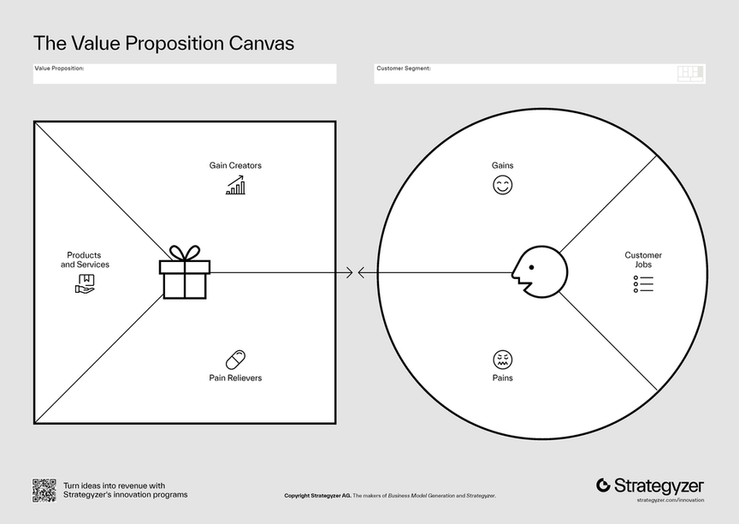
WHO NEEDS THIS? (CUSTOMER & NEED IDENTIFICATION)
Purpose:
To identify your target customer segment(s) and clearly define their needs, frustrations, or gaps that your innovation is addressing.
Specify your customer
Fill in the value proposition canvas
  Products & Services
  Focused on what the customer uses to get the job done. Example: “AI-powered handheld crop diagnostic scanner”
2. Pain Relievers
  Specific ways your product removes barriers, frustrations, or costs. Directly mapped to the pains listed earlier. Example: “Eliminates guesswork and reduces dependency on expensive lab tests.
3. Gain Creators
  Explains how your product improves the customer’s life or business. Example: “Increases productivity and improves income predictability”
CUSTOMER PROFILE (Left column)
  Customer Jobs
  Clearly describes what the customer is trying to accomplish (functionally, socially, emotionally
  What are your customers trying to get done? Example: “Ensure crop health without expert support”
2. Pains
  Specific frustrations, inefficiencies, risks, or costs they face today. Example: “Can’t detect diseases early → leads to major yield loss”
3. Gains
  Tangible and intangible outcomes the customer would love to have. Example: “Easy, low-cost, real-time diagnostics = peace of mind income security”
Mapped Rubric Criteria
PDF1: Customer & Need Identification (10%)
PDF2: Market Readiness (20%)

Slide 4

YOUR SOLUTION & VALUE PROPOSITION
To explain what your innovation is, how it works, why it’s valuable, and how previous proof-of-concept (PoC) or lab results support its feasibility
2. Clear product picture
4. Backed by Proof-of-Concept
  What is the Solution?
  Summarize validation work done (e.g., lab test, prototype, TRL level)
  Include:
    Where it was tested (lab/pilot site)
    How it performed (data/metrics if possible)
    Feedback from early users or experts
  Example: “The sensor was tested on 43 food samples in collaboration with MARDI. Achieved 92% accuracy vs gold-standard lab equipment.”
  Briefly describe the product/system/process
  Mention version/status: Prototype? Beta? Pilot-ready?
  Example: This is a mobile biosensor platform for early food spoilage detection. Our current version is TRL 5 with bench-tested sensors.”
3. Unique Value Proposition
  What makes this better than alternatives?
  Quantify where possible (speed, cost, outcome, compliance)
  Example: “Our device reduces detection time from 6 hours to 5 minutes, at less than RM2 per test.”
Mapped Rubric Criteria
PDF1: Customer Value Proposition (5%)
PDF2: Market Readiness (20%)

Slide 5

EVIDENCE OF DEMAND (MARKET READINESS & ANALYSIS)
To present credible evidence that the market needs and wants your solution, and that your product is getting closer to market fit.
Organic Validation
(Primary Data)
Present actual data you or your team collected via:
  Surveys / Polls
  Interviews / Focus Groups
  Pilot requests
  Website landing page visits
  Social media engagement
  Event sign-ups
  LOIs or MOU leads
  Example:“From our online survey of 61 halal SME manufacturers (2024):
  88.5% said they would trial a portable test kit
  72.1% said they prefer non-lab solutions
  45% already spend >RM500/month on external testing”
  Display Option:
  Pie chart or bar graph + quote from respondent
Formal Market Data (Secondary Data)
  Cite credible market research, policy reports, or industry analysis
  Focus on size, growth, trends, pain points. Example: “According to Frost & Sullivan (2023), the Southeast Asian rapid diagnostic food-tech market is expected to grow at 12.6% CAGR, reaching RM980 million by 2028.”
  Display Option:
  Bar chart or bullet summary of key metrics from the report
Key Insights / Findings
Synthesize both sets of data into 2–3 insights:
Mapped Rubric Criteria
PDF1: Market Analysis (10%)
PDF2: Market Analysis & Competitive Strategy (10%)

Slide 6

HOW IT’S DIFFERENT (COMPETITIVE ADVANTAGE)
To clearly show how your solution is superior or unique compared to existing alternatives
(direct competitors or current practices), and why your advantage is sustainable.
Fill in the competitor table
FEATURE | YOUR PRODUCT | COMPETITOR A | COMPETITOR B | CURRENT PRACTICE
Mapped Rubric Criteria
PDF1: Competitive Advantage (5%)
PDF2: Market Analysis & Competitive Strategy (10%)

Slide 7
OBJECTIVES
This highlights the key objectives of the project/program, outlining the purpose, expected outcomes, and alignment with organizational or funding priorities. It provides clarity on what the project aims to achieve and serves as a reference point for evaluation and monitoring.
a
b
c
Gantt Chart
his presents the project timeline in the form of a Gantt chart, showing major phases, activities, and milestones. It provides a visual overview of the project schedule, enabling easy tracking of progress, dependencies, and deadlines.
Task/Activity | Month 1 | Month 2 | Month 3 | Month 4 | Month 5 | Month 6
Proposal Preparation | ██████
Prototype Development |  | ██████ | ██████
Testing & Validation |  |  | ██████ | ██████
Data Analysis & Refinement |  |  |  | ██████ | ██████
Final Report & Presentation |  |  |  |  | ██████ | ██████
Mapped Rubric Criteria
PDF1: Technology Development Plan (15%)
PDF2: Technology Development Plan (10%)

Slide 8
Technology Development Plan
To present a clear and realistic step-by-step roadmap to take your technology from early research (TRL 1) through to full commercialization (TRL 9), highlighting where you are now, what you aim to do under PDF, and what comes after.
What comes after
TRL 1 | TRL 2 | TRL 3 | TRL 4 | TRL 6 | PDF | TRL 7 | TRL 8
Basic principles observed | Technology concept formulated | YOU ARE HERE Technology validated in relevant | Technology validated in lab | Technique-demonstrated in relevant environment | Systems prototype demonstration in operational environment | System completed and qualified | Full commercialization
Mapped Rubric Criteria
PDF1: Technology Development Plan (15%)
PDF2: Technology Development Plan (10%)

Slide 9










BUSINESS MODEL CANVAS (BMC)
Fill in the BMC
KEY PARTNERSHIPS Who can help us? Support or provide value proposition | KEY ACTIVITIES What must we do? | VALUE PROPOSITIONS It’s the promise of value your business delivers to customers Key elements of a Strong Value Proposition Solves a real problem (pain reliever) Creates a desired gain (gain creator) Clearly explains the value in a way customers care about Is different or better than alternatives | CUSTOMER RELATIONSHIPS How do you attract, retain, and grow your customer base | CUSTOMER SEGMENTS It’s the specific group of people or organizations your business is targeting and serving. Who are your most important users or buyers? What are their key characteristics (age, job, location, habits)? What problems do they need to solve?
 | KEY RESOURCES What must we have? |  | CHANNELS
COST STRUCTURE It describe all the cost and expenses required to operate your business model. |  | REVENUE STREAMS It represents the money your business earns from each Customer Segment
Mapped Rubric Criteria
PDF1: Business Model Canvas (10%)
PDF2: Business Model Canvas (10%)

Slide 10






COMMERCIALISATION STRATEGY
To present a clear, realistic pathway for bringing your innovation to market, including the method of commercialization, who will lead it, and the expected benefits to UTM and society.
Start by stating which of the 3 routes you'll pursue
  Licensing / Technology Sale - IP licensed to industry (local/global), possibly with royalties or upfront fees
  Via UTIM Sdn. Bhd. - Product or training module marketed through UTM’s commercial arm
  Spin-off Company (Syarikat Hiliran) - New company formed to commercialise
Justification for the Chosen Path
  Why is this the most suitable route?
  Who are the potential customers / buyers / users?
  What traction or interest already exists?
Mapped Rubric Criteria
PDF1: Commercialisation Plan (10%)
PDF2: Commercialisation Plan (10%)

Slide 11
PARTNERS & STAKEHOLDERS
To show that your project is supported by credible external parties (industry, government, labs, etc.) — and that you're not working in isolation. This builds confidence, reduces risk, and demonstrates traction.
LOI / MOU Summary
Stakeholder
________________________________________________________________________________________________________________________________________________________________________________________________________________________________
Mapped Rubric Criteria
PDF1: Commercialisation Plan (10%)
PDF2: Commercialisation Plan (10%)

Slide 12

FINANCIAL PLAN & BUDGET JUSTIFICATION
To explain how to spend the project’s money and why those expenses are necessary.
VOT | EXPLAINATION
V11000 (Wages/Salaries/Allowances) | Payment of student living allowance. Payment under the Student Work Scheme (SPB) up to a maximum of RM 500 per month.
V21000 (Travel & Transportation) | Total expenditure for travel, transportation, and subsistence must not exceed 10% (V21000 + V23000) of the project’s total budget.
V24000 (Rental / Communication and Utilities) | Rental is only allowed for equipment, transportation, and other items directly involved in the research.
V27000 (Supplies & Research Materials) | Supply of raw materials related to product development according to objectives/packaging/design and others.
V28000 (Maintenance and Modification) | Maintenance costs are allowed.
V29000 (Professional Services) | Payment of honorarium to the project leader or co-researchers is not allowed.
V35000 (Equipment and Accessories) | Ownership belongs to UTM. The amount requested for this vote must not exceed 40% of the project’s total budget.
B21000 (Travel Allowance Expenditure) | Subject to a limit of 20% of the approved budget allocation.
B3000 (Purchase of Assets & Inventory) | Subject to the project’s requirements and panel approval.
  Justification for funding requested
  Return on investment (to university or market)
Mapped Rubric Criteria
PDF1: Financial Justification & Budgeting (5%)
PDF2: Financial Plan (10%) + Financial Justification (5%)

Slide 13


RISK & MITIGATION
Anticipated risks
Describe the potential issue (technical, market, execution).
IDENTIFIED RISK | IMPACT | PROBABILITY | SEVERITY | MITIGATION STRATEGY
Impact
Briefly indicate how it could affect the project (delay, cost increase, market rejection, etc.).
Mitigation actions
What steps will be taken to prevent or minimise the risk.
Risk status
Use Low / Medium / High (or color codes like green, yellow, red).
Mapped Rubric Criteria
PDF1: Risk & Mitigation (5%)
PDF2: Risk & Mitigation (5%)

Slide 14


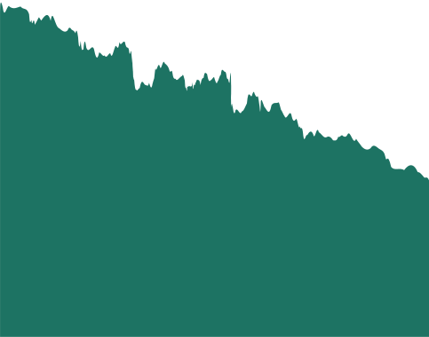
TEAM STRENGTH
To showcase the capability and credibility of your team to:
  Deliver the technical milestones (e.g. TRL advancement),
  Manage validation, certification, and scaling,
  Handle IP, commercialisation, and stakeholder engagement.
Name
Name
Name
Role
Relevant Expertise
Affiliation
Faculty
Role
Relevant Expertise
Affiliation
Faculty
Role
Relevant Expertise
Affiliation
Faculty
Mapped Rubric Criteria
PDF1: Team Capability (5%)
PDF2: Team Capability (5%)

